Slide 1
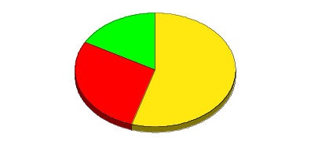
North America Wholesale Gas Network
Cinergy
Hub
Palo
Verde
Hub
Entergy
Hub
Henry
Hub

Slide 2
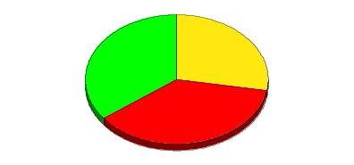
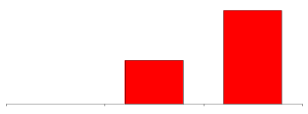
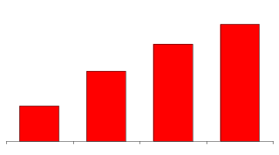
North America Power Wholesale Network
Contract Type by Customer
Peaking Generation
(MW)
2,800
1,300
0
Utilities
Marketers
Others
1998
1999
2000
COB
COB
COB
COB
Hub
Hub
Hub
Hub
COB
Hub
Cinergy
Cinergy
Cinergy
Cinergy
Cinergy
Hub
Hub
Hub
Hub
Hub
Term of Contracts
Number of Counterparties
Palo
Palo
Palo
Palo
Palo
Verde
Verde
Verde
Verde
Verde
Hub
Hub
Hub
Hub
Hub
Entergy
Entergy
Entergy
Entergy
Entergy
Hub
Hub
Hub
Hub
<1Yr
<10Yr
10Yr
Hub
1996
1997
1998
1999
Henry
Henry
Henry
Henry
Henry
Hub
Hub
Hub
Hub
Hub
Marketing Offices
Owned and Leased Capacity
NYMEX Trading
Power Plants
In Operation
Under Development
Power Marketing Activity

